Slide 1
District Finance - Success Plans
Salman Hilmi, DTM
District Finance Manager 2025-26
District 116
District Executive Committee Meeting - 01
DECM -1 Friday 20th June 2025

Slide 2
Mission
To support & help District 116 Leaders achieve the District Mission.
“We build new clubs and support all clubs in achieving excellence.”
Objective
To maintain complete and transparent financial records for District 116 and ensure maximum benefit from the funds available to the District.

Slide 3
Action Plan
Focus on directing financial resources toward achieving the district mission
Funds are to be used by districts in ways which benefit the clubs and members of Toastmasters International within the district
Specific Purposes for which funds can be used:
Promote educational growth
Increase membership in clubs
Establish new clubs.
D116 #InspireInfluenceImpact

Slide 4
Protocol 8.4 (District Fiscal Management)
Use of District Funds
District officers are required to use funds effectively according to the District Success Plan, as well as Toastmasters Policy and Protocol.
Expenses shall be incurred according to the following priorities;
Education and Training
Marketing outside Toastmasters
Club growth and club retention
Membership growth and membership retention
District communication and public relations
D116 #InspireInfluenceImpact

Slide 5
Protocol 8.4 (District Fiscal Management)
Use of District Funds
The following expense categories are also considered important to the District mission; however, the level of priority for the categories below is not strictly mandated and may be determined on an annual basis by the District:
Recognition
Travel and lodging
Food and meals
Speech contests conducted by the District
Administration and District meetings
D116 #InspireInfluenceImpact

Slide 6
Education and Training
This category includes all costs relating to acquiring or printing educational materials, and other costs that directly relate to the training of club officers, division directors and area directors.
Approved Expenses:
Meeting Room Rental, Audio video arrangement
Unapproved Expenses:-
Personal Use expenses, plaques, pins, trophies obtained from other manufacturers, even if it bears toastmasters international trademark or logo
D116 #InspireInfluenceImpact

Slide 7
Marketing
This category includes expenses for purchase and printing of promotional material; cost of materials to attract potential members and clubs.
Approved:
Any expense to promote toastmasters
Plaques, pins, trophies and certificates and other supplies obtained from toastmasters international relating to marketing
Unapproved:
Any expenses personal in nature
Plaques, pins, trophies obtained from other manufacturers, even if it bears toastmasters international trademark or logo
Remarks: Event Invite , Attendance Sheet, Expense vouchers & new club details.
D116 #InspireInfluenceImpact

Slide 8
Communication and Public Relations
This category includes the cost of producing and publishing the district newsletter, website expenses and directory expenses.
Approved:
Supplies, Stationeries, Website Maintenance
Unapproved:
District Telephone, Travels, Any payment for volunteering
D116 #InspireInfluenceImpact

Slide 9
Examples of District Budgeted Expenses
Trainings (Twice Annually)
District Club Officer Trainings
Area & Division Trainings
Club Building
Demo Meetings & Club Formation
Open House (Div Specific)
Speech Contests
Area Contest
Division Contest
Other Expenses
Authorized district officer travel to officially recognized conferences and meetings
(e.g. International Convention)
D116 #InspireInfluenceImpact

Slide 10
Important Timelines (2025-26)
August 2025
31: Year-End Audit (2024-25)
Budget Finalization by Trio & DFM
September 2025
30: Budget Submission to HQ
DECM approves the budget
DCM approves the budget
February 2026
Mid year audit
Protocol 8.4: District Fiscal Management, 3, B
D116 #InspireInfluenceImpact

Slide 11
Budget Timeline for Division / Area / Club
Budget Allocation
TI allocates 25% of membership payments made by clubs in the district during the previous program year (2024-25) to fund the district’s budget for the following year (2025-26).
Divisions / Areas must submit their budgets on or before the 31st August 2024, for the period 1st July 2025 – 30th June 2026.
If any expense is not budgeted, it may not be reimbursed.
Reimbursement requests must be made within 60 days of incurring the expense.
D116 #InspireInfluenceImpact

Slide 12
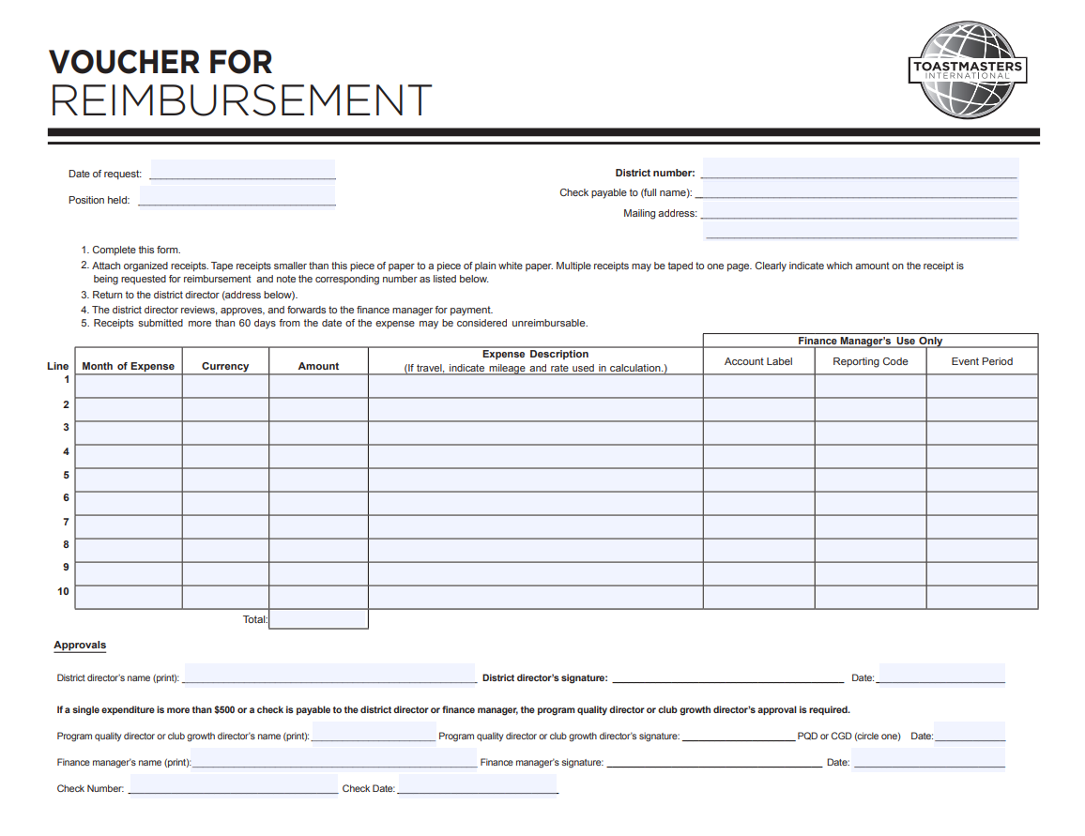
Methodology: How Do We Pay
All approved expenses will be Reimburseable
D116 #InspireInfluenceImpact

Slide 13
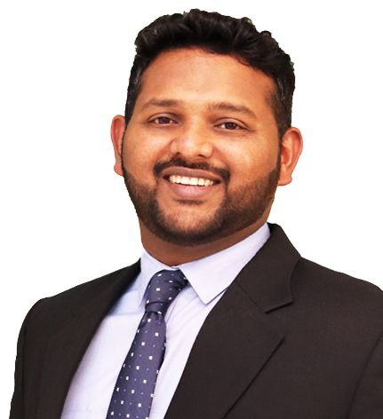
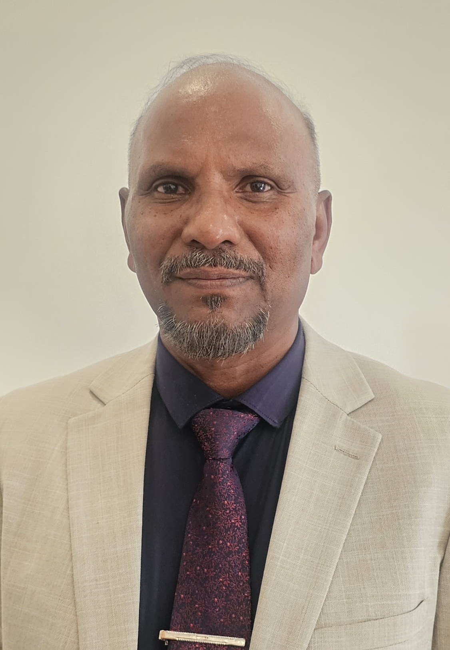
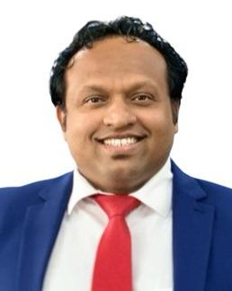
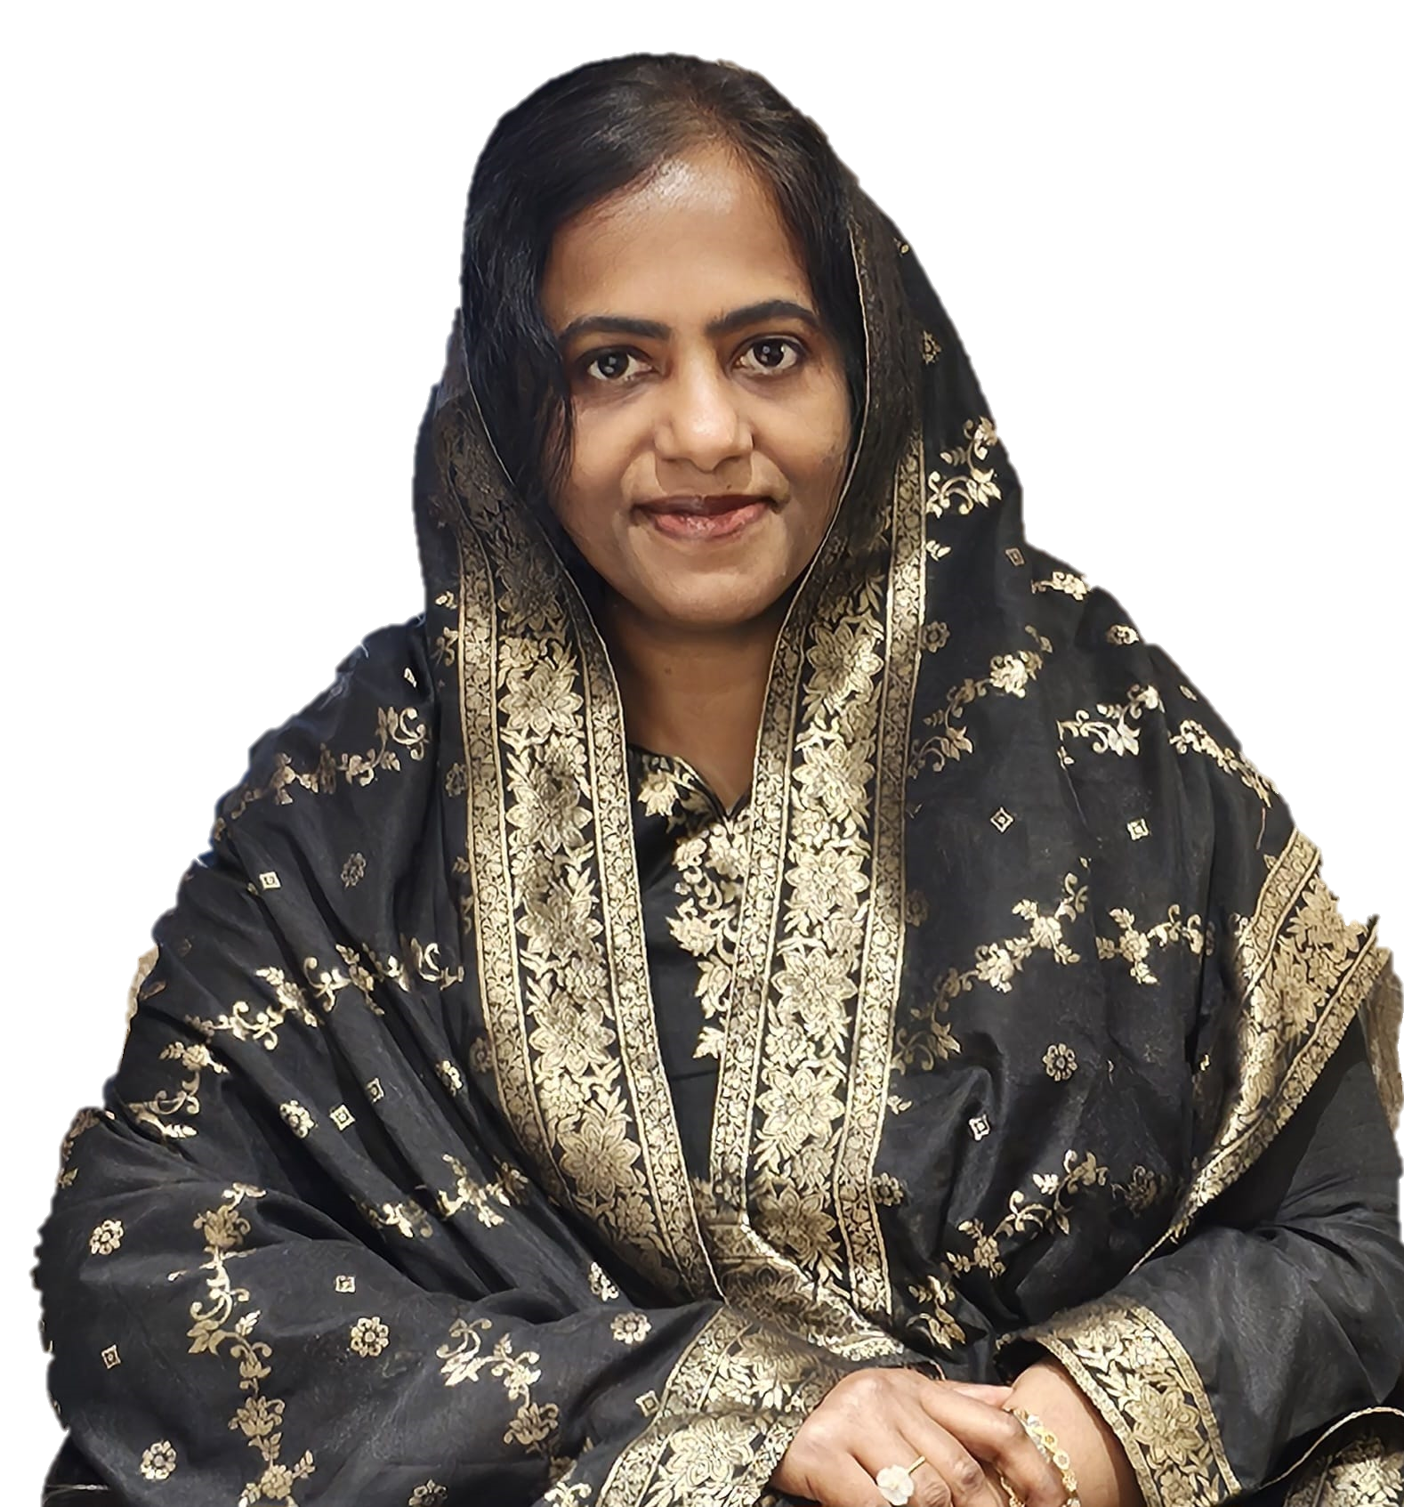
District Finance Team: 2025-26
Ruwan Fernando
Thasni Karedath
Salman Hilmi, DTM
District Finance Manager
Sivakumar Raju, DTM
Advisor to DFM
D116 #InspireInfluenceImpact

Slide 14

THANK YOU
D116 #InspireInfluenceImpact

Slide 15
Examples of District Budgeted Expenses
Trainings (Twice Annually)
District Club Officer Trainings
Area & Division Trainings
Club Officer Training USD 300, Area & Division Training – USD 200 – each twice in a year
Club building – Demo Meeting USD 200, Open House USD 100 Per division
Contests – Area Contest USD 200 per area, Division Contest USD 300 per division
Authorized district officer travel to officially recognized conferences and meetings (e.g. International Convention)
D116 #InspireInfluenceImpact

