Slide 1




DISTRICT 116
PROGRAM
QUALITY AWARDS
2024-2025
#InspireInfluenceImpact
PROGRAM QUALITY AWARDS 2024 - 2025
#AchieveExcellence

Slide 2
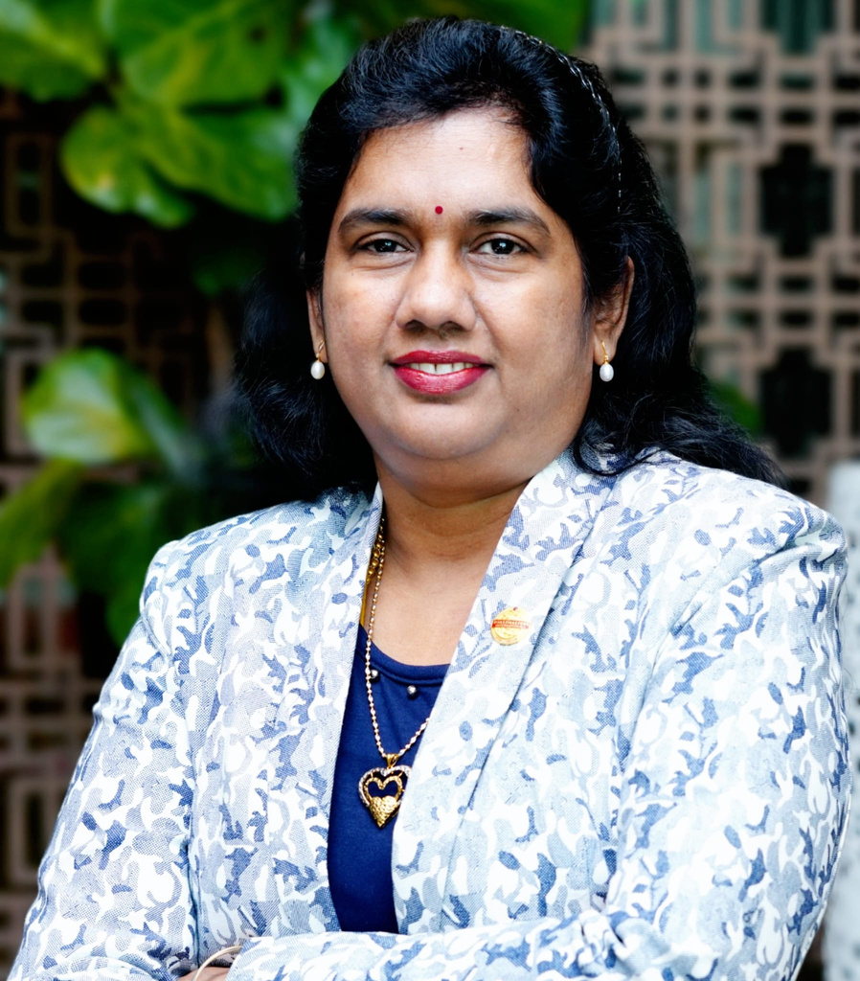
Message from PQD
The purpose of Program Quality Awards is to encourage/motivate every Member, Club, Area and Division for their efforts in upholding the core values of Toastmasters International and aligning with the Club and District Mission.
I wish all our members and clubs achieve maximum number of awards and
Achieve Excellence...
Alar Mel Mangai, DTM
Program Quality Director
2024-2025
#InspireInfluenceImpact
PROGRAM QUALITY AWARDS 2024 - 2025
#AchieveExcellence

Slide 3





PQ Award Categories
MEMBER
CLUB OFFICER
CLUB
AREA
DIVISION
#InspireInfluenceImpact
PROGRAM QUALITY AWARDS 2024 - 2025
#AchieveExcellence

Slide 4
Member Awards
Mode : Dashboard Cut-Off date : 30th April 2025
Pathways Achiever
M1
Achieve any 4 educational awards across paths(at least one L5).
Pathways Super Achiever
M2
Achieve any 6 educational awards across paths (at least one L5).
(*A member get award for either M1 or M2)
Radiant Toastmaster
M3
Contributes minimum 5 educational awards to min 2 different Clubs.
Triple Crown
M4
Achieve 3 educational Awards in this term (including Pathways Mentoring). Awardees will receive the Pins through AD/DD at DTAC.
DTM
M5
Achieve Distinguished Toastmaster status in this term.
Awardees will be recognized at DTAC stage.
Pathways Mentor
M6
Complete Pathways Mentoring Program in this term.
#InspireInfluenceImpact
PROGRAM QUALITY AWARDS 2024 - 2025
#AchieveExcellence

Slide 5

Member Awards
Mode : Application Cut-Off date : 30th April 2025
Passionate Educator
    Present 4 Educational Modules in any Club across District.
    Acceptable module Topics see Annexure 1.
    Module should be minimum 20 mins.
    No repetition of same module topic in one Club.
M7
Inspiring Toastmaster
M8
    Complete or have completed Pathways Mentoring Program.
    Mentor 4 protege to complete min one Level each.
    Club VPE provides Mentor-Mentee Matrix or Add snapshot of mentee’s level completion from Dashboard.
Dynamic Toastmaster
M9
Play roles (other than project speaker) in meetings of 12 Clubs
where the claimant is not a member.
#InspireInfluenceImpact
PROGRAM QUALITY AWARDS 2024 - 2025
#AchieveExcellence

Slide 6
Club Officer Awards
Mode : Application Cut-Off date : 30th April 2025
    Start min 16 meetings in case of normal Club and 8 for Advanced / Specialty Clubs.
    Meeting starts on time as per MOM record or President confirmation
    All facilities arranged in order as per MOM / GE feedback.
Energetic Sergeant at-Arms
CO-1
    MOM for min 16 meetings in case of normal Club & 8 for Advanced / Specialty Clubs.
    MOM posted within 7 days of meeting date.
    Meeting Agenda records maintained in order in a folder.
Smart Secretary
CO-2
#InspireInfluenceImpact
PROGRAM QUALITY AWARDS 2024 - 2025
#AchieveExcellence

Slide 7
Club Officer Awards
Mode : Application Cut-Off date : 30th April 2025
    Achieve Distinguishedstatus on or before 30-Apr-25.
    100% Pathways enrolment (for members until Mar 2025).
    Conducts at least 18 meetings (9 for Advanced / Specialty Clubs).
    Conduct Min 4 Education modules (2 for Advanced /Specialty Clubs).
    Acceptable module Topics see Annexure 1.
    Educational awards claimed for at least 10 distinct members (or 50% of base membership).
    Club conducts Annual Speech Contest.
    Club conducts New Member Orientation at least once.
    Moments Of Truth is conducted with minimum of 50%-member attendance.
Dynamic VPE
CO-3
    Achieve Distinguished status on or before 30-Apr-25.
    Presides minimum 16 regular Club Meetings (8 in case of Advanced / Specialty Clubs).
    Submit Club Success Plan before 15-Aug-24.
    Conducts minimum 4 Ex-Com meetings.
    All 7 Club Officer underwent training in both COT.
    Club does at least one of the following - Sponsor a new Club / Speechcraft / YLP / Community Service event / Open House.
    No net membership loss as on 30-Apr-25 .
Outstanding President
CO-4
#InspireInfluenceImpact
PROGRAM QUALITY AWARDS 2024 - 2025
#AchieveExcellence

Slide 8
Club Awards
Mode : Dashboard Cut-Off date : 30th April 2025
Fast Track Club
C1
Achieve minimum 2 out of 6 DCP Educational Goals on or before
30-Sep-2024.
Swift Five Club
C2
Achieve 5 DCP Goals as on 31-Dec-24.
Fleet Seven Club
C3
Achieve 7 DCP Goals as on 31-Mar-25.
Turbo Ten Club
C4
Achieve 10 DCP Goals on or before 30-Apr-25
Dynamo Club
C5
Achieve Distinguished Status before 30-April-25.
Super Seven Club
C6
All 7 Club Officer are trained in both rounds of COT.
#InspireInfluenceImpact
PROGRAM QUALITY AWARDS 2024 - 2025
#AchieveExcellence

Slide 9
Club Awards
Mode : Dashboard Cut-Off date : 30th April 2025
Educational Excellence Club
C7
Ratio of educational awards to base membership is equal to or
greater than 0.4
Buzzing Club
C8
Clubs with 5 and more members achieve triple crown
Emerging Club
C9
Awarded to new clubs that are chartered on or before 31-Mar-25 & become Distinguished before 30-Apr-25.
Hat trick Excellence
C10
Achieve President's Distinguished Status for 3 consecutive years.
#InspireInfluenceImpact
PROGRAM QUALITY AWARDS 2024 - 2025
#AchieveExcellence

Slide 10
Club Awards
Mode : Application Cut-Off date : 30th April 2025
C11
  Awarded to clubs that organizes any two of following:
  YLP / Speechcraft / Community Service Event (Blood Donation, Environment Cleaning, Tree Plantation, Labour Camp Educations, etc.)
Community Service
Awarded to Clubs which meets following criteria:
  Achieve President's Distinguished status.
  100% Pathways enrollment (for members until Mar 2025).
  Minimum 5 Educational Goals.
  Conduct minimum 4 Education modules (2 for Advanced /
Specialty Clubs). (Cut-Off Nov. 30, 2024)
  Acceptable module Topics see Annexure 1.
  Club conducts Annual Speech Contest.
  No net membership loss as on 30-Apr-2025.
Outstanding Club Award
C12
#InspireInfluenceImpact
PROGRAM QUALITY AWARDS 2024 - 2025
#AchieveExcellence

Slide 11
Club Awards
Mode : Application Cut-Off date : 30th April 2025
    Awarded to Clubs that meets C12 plus the following:
    Achieve 10 DCP goals.
    Conduct min 20 meetings. (10 in case of Advanced / Specialty Clubs).
    At least 15 members attend min 15 Club meetings (8 for Advanced Specialty Clubs). (Attendance register copy / proof to be submitted)
    Conducted the Moments of Truth module at least one time before 31-Oct-24.
    Conducted New Member Orientation minimum twice before.
(One before 30-Sep-24).
    All 7 Club Officer are trained in both rounds of COT.
    Active members not less than 25 as on 30-Apr-25.
    Both President and VPE must attend all the District Council meetings in person.
    Agenda must be released / circulated minimum three days prior to the meeting. (Share Agenda to District Council WhatsApp/
associated social groups & same can be proof to attach during
application.
    Minimum Five active members of the Club as on workshop date, attend District organized Judges Training.
Golden Gavel Award
C13
#InspireInfluenceImpact
PROGRAM QUALITY AWARDS 2024 - 2025
#AchieveExcellence

Slide 12
Area Awards
Mode : Application Cut-Off date : 30th April 2025
    Total Education awards minimum average of 7 per Club. (Club count shall be base numbers)
    All base Clubs conduct MOT & New member Orientation.
    Base number of Clubs attains minimum Distinguished status on or before 30-Apr-25. Cut-off 30-Jun-25.
Outstanding AAD PQ
A1
  Submit Area Success Plan on or before 15-Aug-24.
  Achieve President's Distinguished Area status by 30-Apr-25.
  Minimum net growth of Club +1 on or before 31-Mar-25.
  Total Educational Awards to Area base members count ratio is not less than 0.6
  Ensure all Clubs conduct New Member Orientation.
  Conduct MOT in all base Clubs before 31-Oct-24.
  Conduct MOT in new clubs before 30-Apr-25 (chartered on or before 31-Oct-24).
  Conduct Confluence Meeting before 31-Mar-25 (All Clubs in the Area must be involved in role plays or speeches)
  Minimum of two in the Area - Speechcraft/ Open house / Demo Meeting) in the Area.
  Conducts minimum two Area Ex-Com Meetings. Agenda or Attendance Proof
  Net membership increase by 20% including new Club.
Outstanding Area Director
A3
Mode : Dashboard Cut-Off date : 30th April 2025
Super Area
A2
Area achieves President's Distinguished Area status by 30-Apr-25
No net loss of membership
#InspireInfluenceImpact
PROGRAM QUALITY AWARDS 2024 - 2025
#AchieveExcellence

Slide 13
Division Awards
Mode : Application Cut-Off date : 30th April 2025
  Total Education awards minimum average of 7 per Club. (Club count shall be base numbers).
  Base number of Clubs attains minimum Distinguished status on or before 30-Apr-25.
  Division conduct three TLI workshops with diversified topics for Clubs & Members.
Outstanding ADD PQ
D1
  Submit Division Success Plan on or before 31-Aug-24.
  Achieves President's Distinguished Division status on or before 30-Apr-25.
  Minimum net Club Growth +2 on or before 31-Mar-25.
  Total Educational Awards to Division base members count ratio is not less than 0.5
  Conduct minimum two Division Council Meetings. Attendance & Agenda Proof.
  Minimum of 2 in the Division - Speechcraft/Open house/Demo Meeting
  Net membership increase by 20% including new Clubs.
  Conduct min three TLI workshops & before 30-Sep-24 include one training on Quality Club Environment &/or Membership Retention
Outstanding Division Director
D3
Mode : Dashboard Cut-Off date : 30th April 2025
Super Division
D2
Division achieves President's Distinguished Division status on or
before 30-Apr-25. No net loss of membership
#InspireInfluenceImpact
PROGRAM QUALITY AWARDS 2024 - 2025
#AchieveExcellence

Slide 14
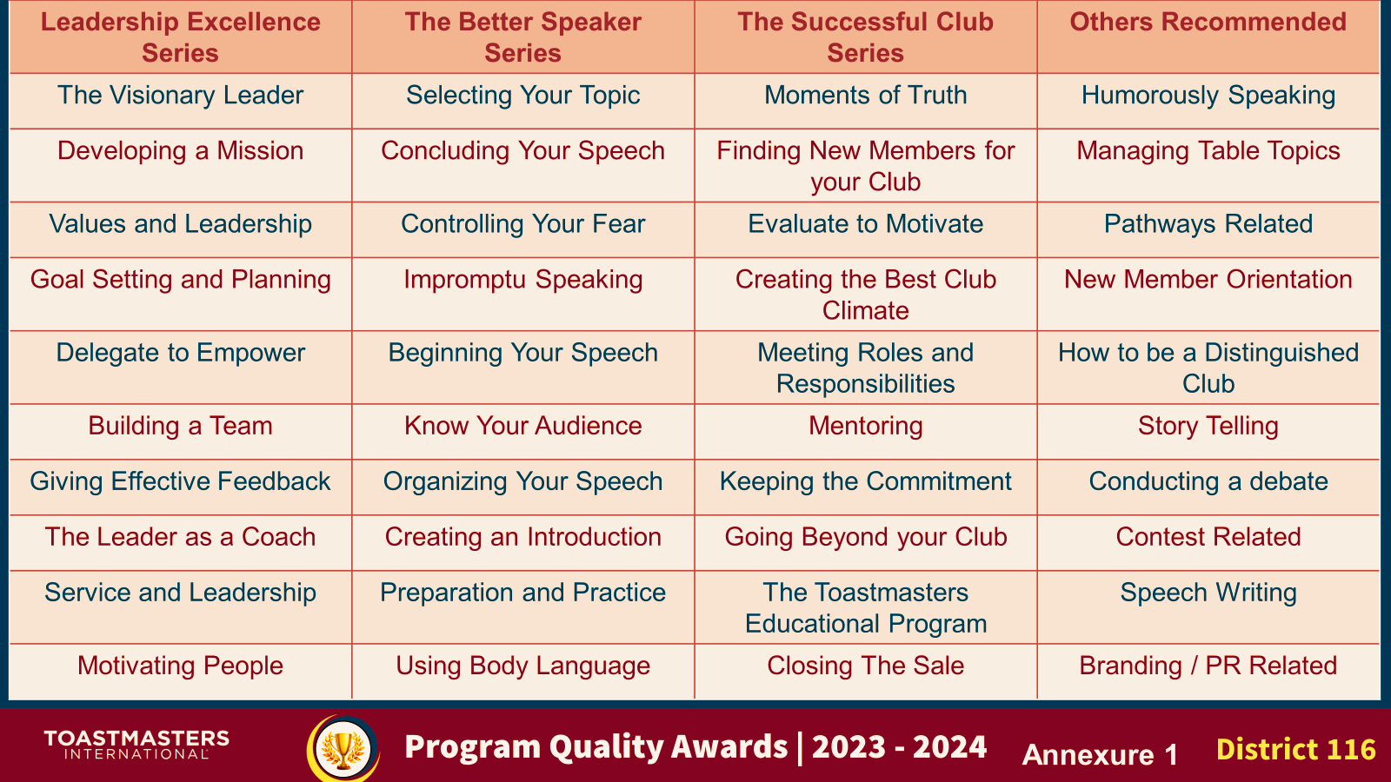
Annexure
#InspireInfluenceImpact
PROGRAM QUALITY AWARDS 2024 - 2025
#AchieveExcellence

Slide 15
Additional Notes
Awards application links
Member | https://forms.gle/DL2UJmD4WdU7ao5B8
Club Officer | https://forms.gle/8gLMSc2cZnTyBcfZ8
Club | https://forms.gle/FD8q3v7Da3HL7BXC8
Area | https://forms.gle/W5Mj8f2BWjcZyD6r5
Division | https://forms.gle/ejt5UD7VgJ3kJunQ7
  Program Quality Awards Period :
01-Jul-2024 to 30-Jun-2025.
  All educational awards claims done in Club Central on or before 30-Apr-25.
  Awards will be compiled as per respective cut-off date and will be verified according to the criteria.
  Data shall be verified from TI dashboard with respect to cut-off date or later.
  In case of Awards that need an Application, a google link / form will be shared.
  Awards with deadlines prior to DTAC 2025 will be given in the event & other awards will be given later.
Awards Chair : Lornalyn Tallod, DTM
Awards Co-Chair : Ajaya Rogiye, DTM
Contact Us : 3396 2047 / 7732 0575
Email :pqdd116@gmail.com
#InspireInfluenceImpact
PROGRAM QUALITY AWARDS 2024 - 2025
#AchieveExcellence

Slide 16
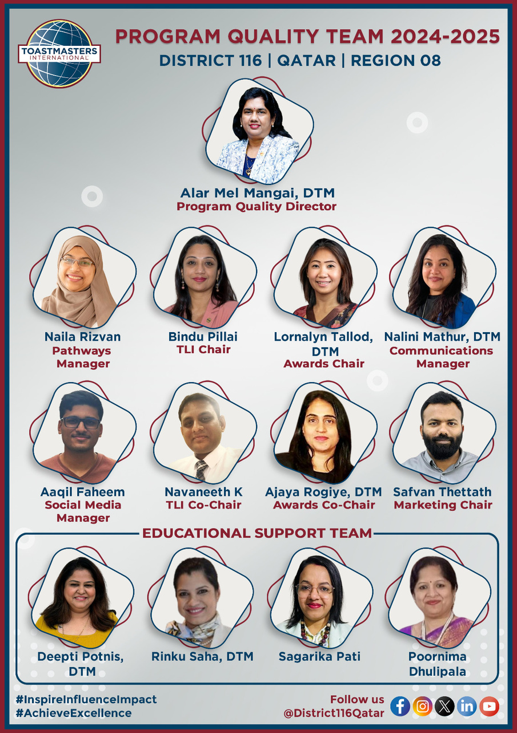
Program Quality Team
#InspireInfluenceImpact
PROGRAM QUALITY AWARDS 2024 - 2025
#AchieveExcellence

Slide 17

District Mission
We build new clubs and support all clubs in achieving excellence.
#InspireInfluenceImpact
PROGRAM QUALITY AWARDS 2024 - 2025
#AchieveExcellence

